Slide 1
Bio & 241 A&P 1
Unit 3 / Lab 4

Slide 2
Histology Slides for Muscle Tissues
Slides are presented in order of magnification if different view are presented.
As you view the following slides, make sure you can accomplish these goals:
Can you identify the tissue observable on the slides?
Can you identify the specific structures or layers indicated by the numbered arrows or brackets?
At the end of a sequence, you will find the answers to the above for each slide.

Slide 3
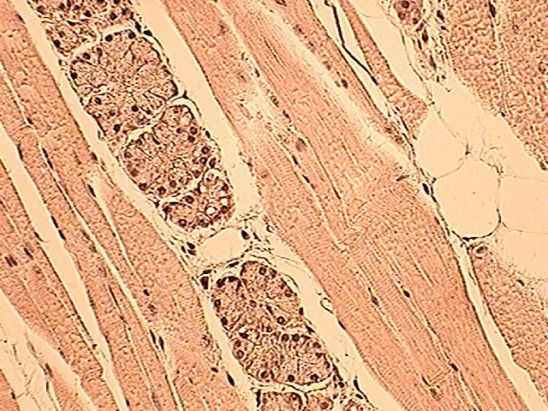
Type of Muscle Tissue?
1
3
2
1
400X

Slide 4
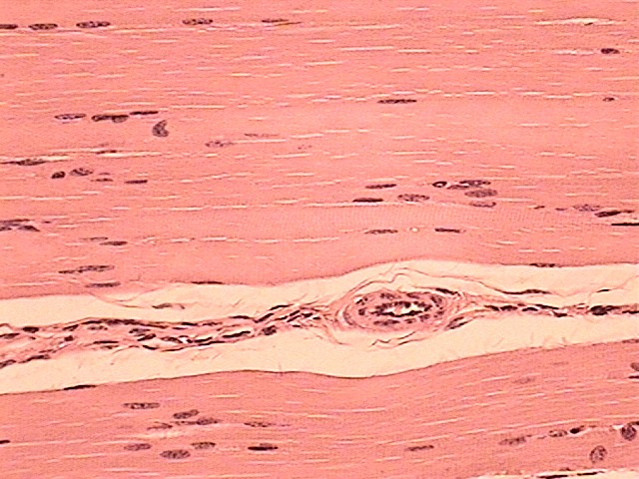
Type of Muscle Tissue?
1
2
4
400X

Slide 5
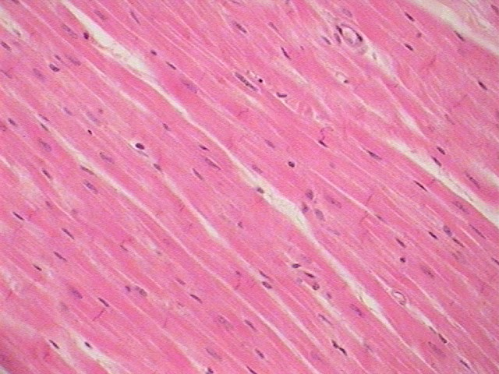
Type of Muscle Tissue?
6
5
5
7
400X

Slide 6
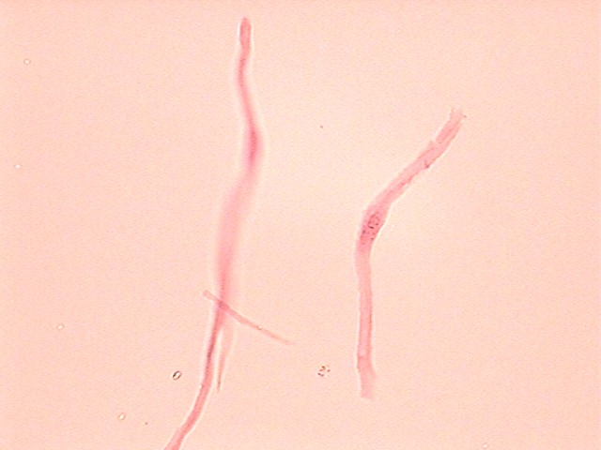
8

Slide 7
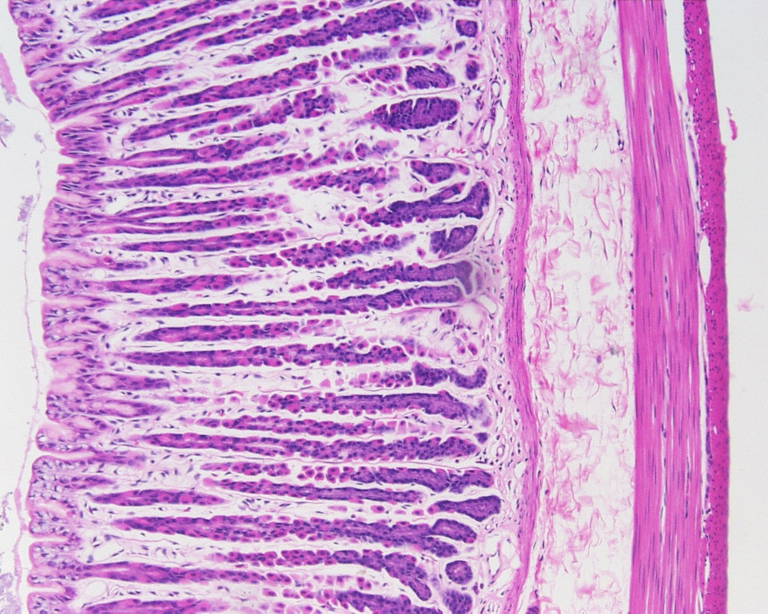
Type of Muscle Tissue?
9
10
100X

Slide 8
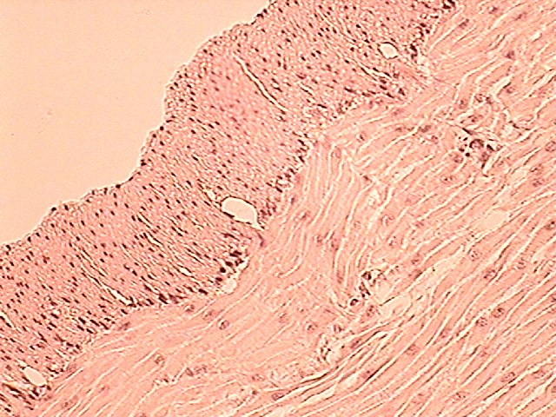
Type of Muscle Tissue?
9
10
11
400X

Slide 9
Answers to Slides 2 through 7
Slide 2: Skeletal Muscle showing both longitudinal and transverse views
Slide 3: Skeletal Muscle in longitudinal view
Slide 4: Cardiac Muscle in longitudinal view
Slide 5: Individual smooth muscle cell
Slide 6: Transverse section of the GI tract showing muscle layers
Slide 7: High power view of transverse section of the GI tract showing muscle layers
Numbered arrows:
Peripheral nuclei of skeletal muscle cells. Note multiple nuclei associated with each cell
A and I bands of a skeletal muscle fiber
Blood vessel in the perimysium
Perimysium between muscle fascicles
Intercalated discs
Branching fibers

Slide 10
Answers to Slides 2 through 7
Centrally located nucleus
Isolated single smooth muscle cells with nucleus
Longitudinal smooth muscle layer of GI tract wall
Circular smooth muscle layer of the GI tract wall
Spindle-shaped smooth muscle cells

Slide 11
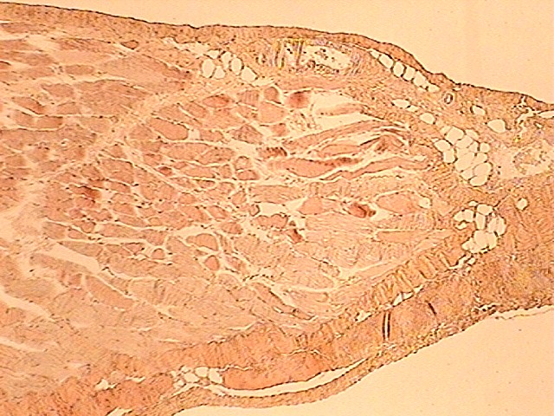
100X
14
13
15
12
16
14

Slide 12
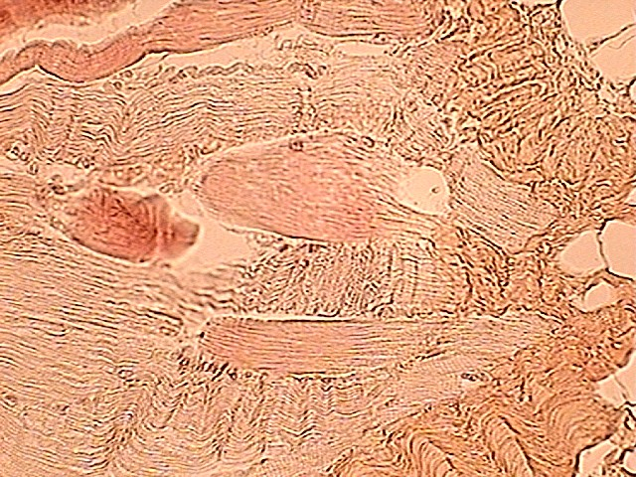
400X
15
13
15

Slide 13
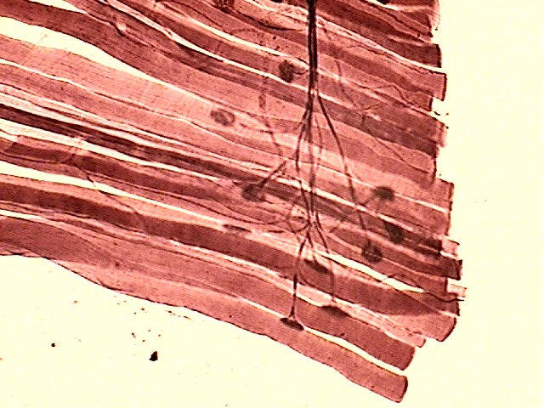
100X
18
17
19
20
13
20

Slide 14
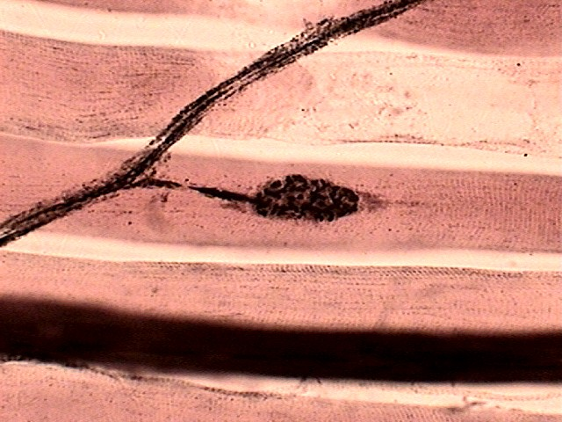
400X
18
20
2

Slide 15
Answers to Slides 10 through 13
Slide 10: Muscle-Tendon intersection low power
Slide 11: Muscle-Tendon intersection high power
Slide 12: Neuromuscular junction low power
Slide 13: Neuromuscular junction high power
Numbered arrows:
12. Skeletal Muscle
Skeletal muscle cell
Epimysium surrounding muscle
Endomysium joining the tendon
Tendon
Portion of a Motor unit of a muscle
Motor nerve
Axon from a motor nerve
Neuromuscular junction with Ach vesicles

Slide 16
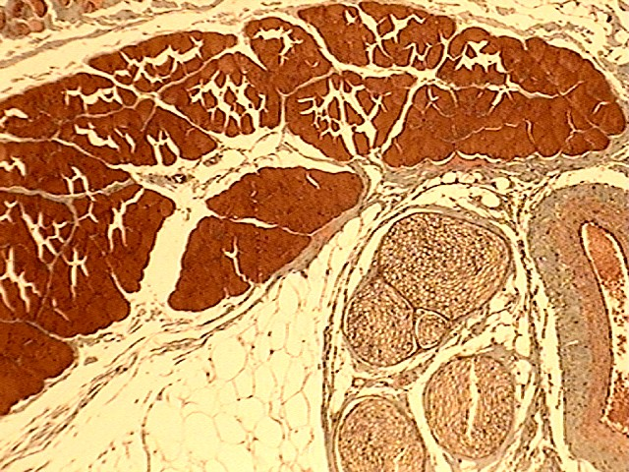
3
5
3
4
1
2
5
6

Slide 17
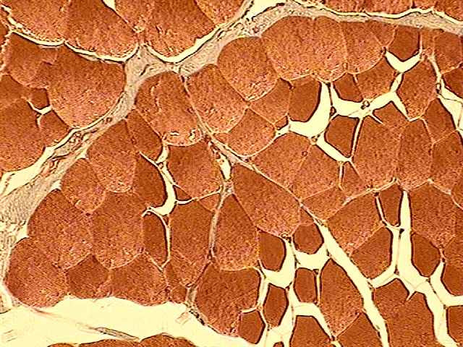
5
6
7
7

Slide 18
Answers to slides 15 through 13
Slide 15-16: Nerve artery vein slide with Masson stain for connective tissue
Numbered Arrows:
Transverse section through a nerve
Vein
Transverse section through a muscle fascicle
Epimysium covering the muscle
Perimysium surrounding a muscle fascicle
Adipose Tissue
Endomysium surrounding muscle fibers

